Slide 1
CS162 Operating Systems and Systems Programming Lecture 4 Introduction to I/O, Sockets, Networking
September 5th, 2018
Prof. Ion Stoica
http://cs162.eecs.Berkeley.edu

Slide 2
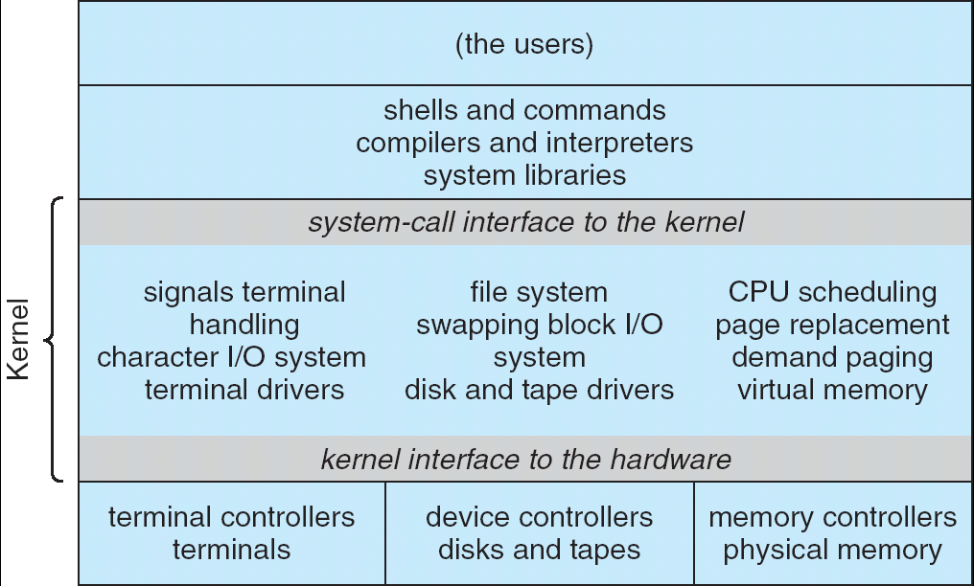
Recall: UNIX System Structure
Applications
User Mode
Standard Libs
Kernel Mode
Hardware

Slide 3
Key Unix I/O Design Concepts
Uniformity
file operations, device I/O, and interprocess communication through open, read/write, close
Allows simple composition of programs
find | grep | wc …
Open before use
Provides opportunity for access control and arbitration
Sets up the underlying machinery, i.e., data structures
Byte-oriented
Even if blocks are transferred, addressing is in bytes
Kernel buffered reads
Streaming and block devices looks the same
read blocks process, yielding processor to other task

Slide 4
Putting it together: web server
Kernel buffer reads
Server
4. parse request
9. format reply
request
buffer
reply
buffer
network
socket
read
3. kernel
copy
10. network
socket
write
5. file
read
8. kernel
copy
syscall
syscall
Kernel
wait
RTU
11. kernel copy
from user buffer
to network buffer
RTU
interrupt
interrupt
2. copy arriving
packet (DMA)
12. format outgoing
packet and DMA
6. disk
request
7. disk data
(DMA)
Hardware
Network
interface
Disk interface
Request
Reply

Slide 5
Key Unix I/O Design Concepts
Uniformity
file operations, device I/O, and interprocess communication through open, read/write, close
Allows simple composition of programs
find | grep | wc …
Open before use
Provides opportunity for access control and arbitration
Sets up the underlying machinery, i.e., data structures
Byte-oriented
Even if blocks are transferred, addressing is in bytes
Kernel buffered reads
Streaming and block devices looks the same
read blocks process, yielding processor to other task
Kernel buffered writes
Completion of out-going transfer decoupled from the application, allowing it to continue

Slide 6
Putting it together: web server
Kernel buffer writes
Server
4. parse request
9. format reply
request
buffer
reply
buffer
network
socket
read
3. kernel
copy
10. network
socket
write
5. file
read
8. kernel
copy
syscall
syscall
Kernel
wait
RTU
11. kernel copy
from user buffer
to network buffer
RTU
interrupt
interrupt
2. copy arriving
packet (DMA)
12. format outgoing
packet and DMA
6. disk
request
7. disk data
(DMA)
Hardware
Network
interface
Disk interface
Request
Reply

Slide 7
Key Unix I/O Design Concepts
Uniformity
file operations, device I/O, and interprocess communication through open, read/write, close
Allows simple composition of programs
find | grep | wc …
Open before use
Provides opportunity for access control and arbitration
Sets up the underlying machinery, i.e., data structures
Byte-oriented
Even if blocks are transferred, addressing is in bytes
Kernel buffered reads
Streaming and block devices looks the same
read blocks process, yielding processor to other task
Kernel buffered writes
Completion of out-going transfer decoupled from the application, allowing it to continue
Explicit close

Slide 8
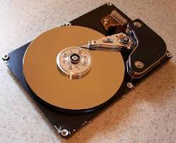
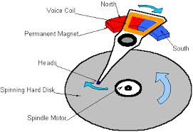
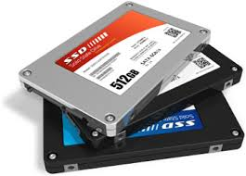

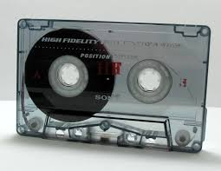
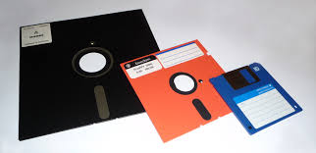
I/O & Storage Layers
Application / Service
High Level I/O
streams
Low Level I/O
handles
Syscall
registers
File System
descriptors
I/O Driver
Commands and Data Transfers
Disks, Flash, Controllers, DMA

Slide 9
The File System Abstraction
High-level idea
Files live in hierarchical namespace of filenames
File
Named collection of data in a file system
File data
Text, binary, linearized objects
File Metadata: information about the file
Size, Modification Time, Owner, Security info
Basis for access control
Directory
“Folder” containing files & Directories
Hierachical (graphical) naming
Path through the directory graph
Uniquely identifies a file or directory
/home/ff/cs162/public_html/fa18/index.html
Links and Volumes (later)

Slide 10
C High-Level File API – Streams (review)
Operate on “streams” - sequence of bytes, whether text or data, with a position
#include <stdio.h>
FILE *fopen( const char *filename, const char *mode );
int fclose( FILE *fp );
Mode Text | Binary | Descriptions
r | rb | Open existing file for reading
w | wb | Open for writing; created if does not exist
a | ab | Open for appending; created if does not exist
r+ | rb+ | Open existing file for reading & writing.
w+ | wb+ | Open for reading & writing; truncated to zero if exists, create otherwise
a+ | ab+ | Open for reading & writing. Created if does not exist. Read from beginning, write as append
Don’t forget to flush

Slide 11
Connecting Processes, Filesystem, and Users
Process has a ‘current working directory’
Absolute Paths
/home/ff/cs162
Relative paths
index.html, ./index.html - current WD
../index.html - parent of current WD
~, ~cs162 - home directory

Slide 12
C API Standard Streams
Three predefined streams are opened implicitly when a program is executed
FILE *stdin – normal source of input, can be redirected
FILE *stdout – normal source of output, can be redirected
FILE *stderr – diagnostics and errors, can be redirected
STDIN / STDOUT enable composition in Unix
Recall: Use of pipe symbols connects STDOUT and STDIN
find | grep | wc …

Slide 13

C high level File API – Stream Ops
#include <stdio.h>
// character oriented
int fputc( int c, FILE *fp ); // rtn c or EOF on err
int fputs( const char *s, FILE *fp ); // rtn >0 or EOF
int fgetc( FILE * fp );
char *fgets( char *buf, int n, FILE *fp );

Slide 14
C high level File API – Stream Ops
#include <stdio.h>
// character oriented
int fputc( int c, FILE *fp ); // rtn c or EOF on err
int fputs( const char *s, FILE *fp ); // rtn >0 or EOF
int fgetc( FILE * fp );
char *fgets( char *buf, int n, FILE *fp );
// block oriented
size_t fread(void *ptr, size_t size_of_elements,
size_t number_of_elements, FILE *a_file);
size_t fwrite(const void *ptr, size_t size_of_elements,
size_t number_of_elements, FILE *a_file);

Slide 15
C high level File API – Stream Ops
#include <stdio.h>
// character oriented
int fputc( int c, FILE *fp ); // rtn c or EOF on err
int fputs( const char *s, FILE *fp ); // rtn >0 or EOF
int fgetc( FILE * fp );
char *fgets( char *buf, int n, FILE *fp );
// block oriented
size_t fread(void *ptr, size_t size_of_elements,
size_t number_of_elements, FILE *a_file);
size_t fwrite(const void *ptr, size_t size_of_elements,
size_t number_of_elements, FILE *a_file);
// formatted
int fprintf(FILE *restrict stream, const char *restrict format, ...);
int fscanf(FILE *restrict stream, const char *restrict format, ...);

Slide 16
Example Code
#include <stdio.h>
#define BUFLEN 256
FILE *outfile;
char mybuf[BUFLEN];
int storetofile() {
char *instring;
outfile = fopen("/usr/homes/testing/tokens", "w+");
if (!outfile)
return (-1); // Error!
while (1) {
instring = fgets(mybuf, BUFLEN, stdin); // catches overrun!
// Check for error or end of file (^D)
if (!instring || strlen(instring)==0) break;
// Write string to output file, exit on error
if (fputs(instring, outfile)< 0) break;
}
fclose(outfile); // Flushes from userspace
}

Slide 17
C Stream API positioning
int fseek(FILE *stream, long int offset, int whence); long int ftell (FILE *stream)
void rewind (FILE *stream)
High Level I/O
offset (SEEK_SET)
offset (SEEK_END)
Low Level I/O
whence
Syscall
File System
offset (SEEK_CUR)
I/O Driver
Preserves high level abstraction of uniform stream of objects
Adds buffering for performance

Slide 18
What’s below the surface ??
Application / Service
High Level I/O
streams
Low Level I/O
handles
Syscall
registers
File System
descriptors
I/O Driver
commands and Data Transfers
disks, flash, controllers, DMA

Slide 19
C Low level I/O
Operations on File Descriptors – as OS object representing the state of a file
User has a “handle” on the descriptor
#include <fcntl.h>
#include <unistd.h>
#include <sys/types.h>
int open (const char *filename, int flags [, mode_t mode])
int creat (const char *filename, mode_t mode)
int close (int filedes)
Bit vector of:
Access modes (Rd, Wr, …)
Open Flags (Create, …)
Operating modes (Appends, …)
Bit vector of Permission Bits:
User|Group|Other X R|W|X
http://www.gnu.org/software/libc/manual/html_node/Opening-and-Closing-Files.html

Slide 20
C Low Level: standard descriptors
#include <unistd.h>
STDIN_FILENO - macro has value 0
STDOUT_FILENO - macro has value 1
STDERR_FILENO - macro has value 2
int fileno (FILE *stream)
FILE * fdopen (int filedes, const char *opentype)
Crossing levels: File descriptors vs. streams
Don’t mix them!

Slide 21
C Low Level Operations
ssize_t read (int filedes, void *buffer, size_t maxsize)
- returns bytes read, 0 => EOF, -1 => error
ssize_t write (int filedes, const void *buffer, size_t size)
- returns bytes written
off_t lseek (int filedes, off_t offset, int whence)
int fsync (int fildes) – wait for i/o to finish
void sync (void) – wait for ALL to finish
When write returns, data is on its way to disk and can be read, but it may not actually be permanent!

Slide 22
And lots more !
TTYs versus files
Memory mapped files
File Locking
Asynchronous I/O
Generic I/O Control Operations
Duplicating descriptors
int dup2 (int old, int new)
int dup (int old)
Notes:
The dup2() system call is similar to dup() but the basic difference between them is that instead of using the lowest-numbered unused file descriptor, it uses the descriptor number specified by the user.

Slide 23
Another example: lowio-std.c
#include <stdlib.h>
#include <stdio.h>
#include <string.h>
#include <unistd.h>
#include <sys/types.h>
#define BUFSIZE 1024
int main(int argc, char *argv[])
{
char buf[BUFSIZE];
ssize_t writelen = write(STDOUT_FILENO, "I am a process.\n", 16);
ssize_t readlen = read(STDIN_FILENO, buf, BUFSIZE);
ssize_t strlen = snprintf(buf, BUFSIZE,"Got %zd chars\n", readlen);
writelen = strlen < BUFSIZE ? strlen : BUFSIZE;
write(STDOUT_FILENO, buf, writelen);
exit(0);
}

Slide 24
Administrivia
Waitlist was closed last Friday
Recommendation: Read assigned readings before lecture
Group sign up this week
Get finding groups ASAP – deadline Friday 9/7 at 11:59PM
4 people in a group!
TA preference signup form due Monday 9/10 at 11:59PM
Everyone in a group must have the same TA!
Preference given to same section
Participation: Get to know your TA!

Slide 25
Break

Slide 26
What’s below the surface ??
Application / Service
High Level I/O
streams
Low Level I/O
handles
Syscall
registers
File System
descriptors
I/O Driver
Commands and Data Transfers
Disks, Flash, Controllers, DMA

Slide 27
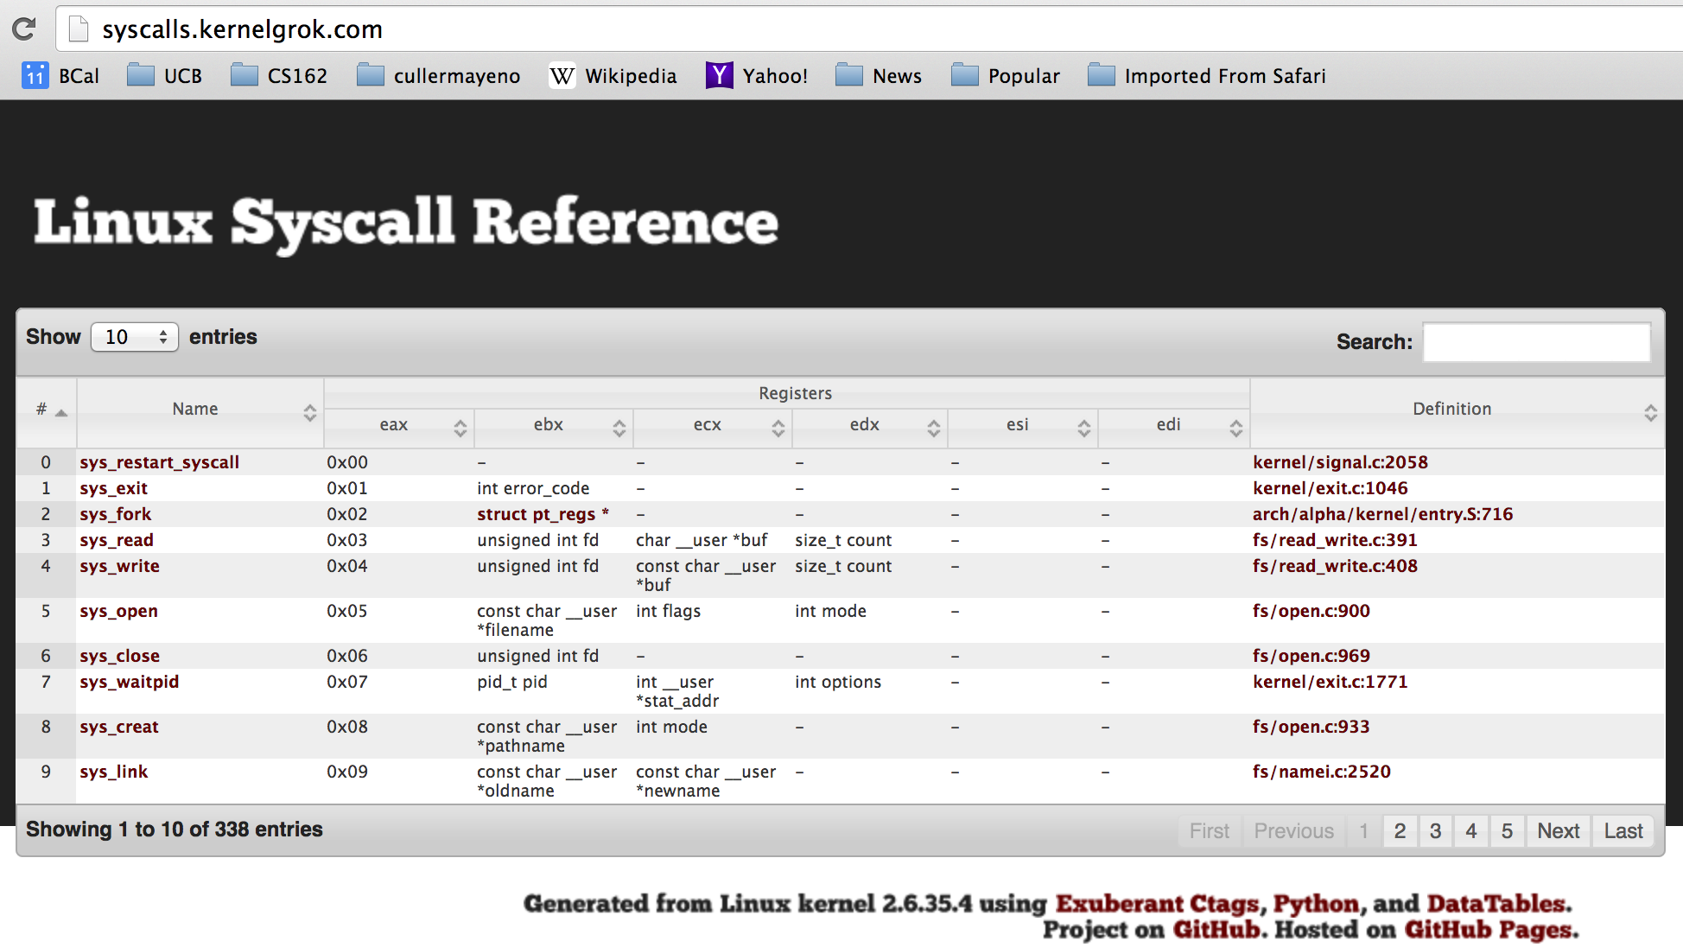
Recall: SYSCALL
Low level lib parameters are set up in registers and syscall instruction is issued
A type of synchronous exception that enters well-defined entry points into kernel

Slide 28
What’s below the surface ??
File descriptor number
- an int
Application / Service
High Level I/O
streams
Low Level I/O
handles
Syscall
registers
File System
descriptors
File Descriptors
a struct with all the info about the files
I/O Driver
Commands and Data Transfers
Disks, Flash, Controllers, DMA

Slide 29
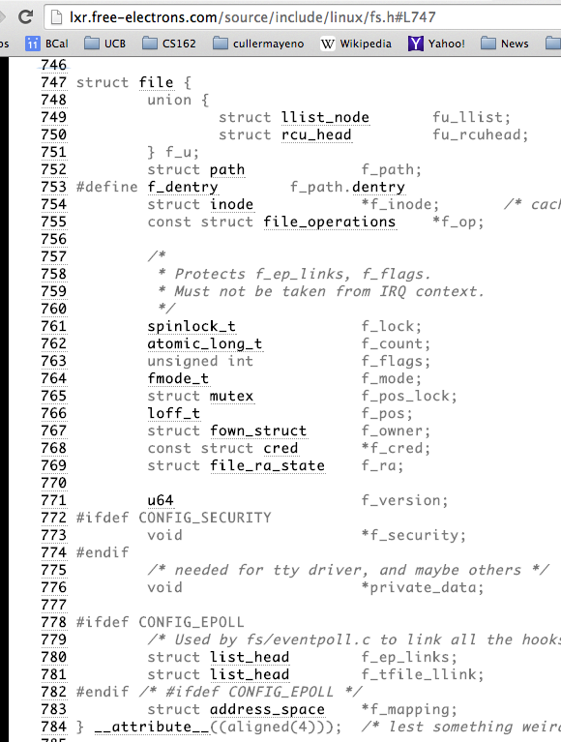
Internal OS File Descriptor
Internal Data Structure describing everything about the file
Where it resides
Its status
How to access it
Pointer: struct file *file

Slide 30
File System: from syscall to driver
In fs/read_write.c
ssize_t vfs_read(struct file *file, char __user *buf, size_t count, loff_t *pos)
{
ssize_t ret;
if (!(file->f_mode & FMODE_READ)) return -EBADF;
if (!file->f_op || (!file->f_op->read && !file->f_op->aio_read))
return -EINVAL;
if (unlikely(!access_ok(VERIFY_WRITE, buf, count))) return -EFAULT;
ret = rw_verify_area(READ, file, pos, count);
if (ret >= 0) {
count = ret;
if (file->f_op->read)
ret = file->f_op->read(file, buf, count, pos);
else
ret = do_sync_read(file, buf, count, pos);
if (ret > 0) {
fsnotify_access(file->f_path.dentry);
add_rchar(current, ret);
}
inc_syscr(current);
}
return ret;
}
Read up to “count” bytes from “file” starting from “pos” into “buf”.
Return error or number of bytes red.

Slide 31
File System: from syscall to driver
In fs/read_write.c
ssize_t vfs_read(struct file *file, char __user *buf, size_t count, loff_t *pos)
{
ssize_t ret;
if (!(file->f_mode & FMODE_READ)) return -EBADF;
if (!file->f_op || (!file->f_op->read && !file->f_op->aio_read))
return -EINVAL;
if (unlikely(!access_ok(VERIFY_WRITE, buf, count))) return -EFAULT;
ret = rw_verify_area(READ, file, pos, count);
if (ret >= 0) {
count = ret;
if (file->f_op->read)
ret = file->f_op->read(file, buf, count, pos);
else
ret = do_sync_read(file, buf, count, pos);
if (ret > 0) {
fsnotify_access(file->f_path.dentry);
add_rchar(current, ret);
}
inc_syscr(current);
}
return ret;
}
Make sure we are allowed to read this file

Slide 32
File System: from syscall to driver
In fs/read_write.c
ssize_t vfs_read(struct file *file, char __user *buf, size_t count, loff_t *pos)
{
ssize_t ret;
if (!(file->f_mode & FMODE_READ)) return -EBADF;
if (!file->f_op || (!file->f_op->read && !file->f_op->aio_read))
return -EINVAL;
if (unlikely(!access_ok(VERIFY_WRITE, buf, count))) return -EFAULT;
ret = rw_verify_area(READ, file, pos, count);
if (ret >= 0) {
count = ret;
if (file->f_op->read)
ret = file->f_op->read(file, buf, count, pos);
else
ret = do_sync_read(file, buf, count, pos);
if (ret > 0) {
fsnotify_access(file->f_path.dentry);
add_rchar(current, ret);
}
inc_syscr(current);
}
return ret;
}
Check if file has read methods

Slide 33
File System: from syscall to driver
In fs/read_write.c
ssize_t vfs_read(struct file *file, char __user *buf, size_t count, loff_t *pos)
{
ssize_t ret;
if (!(file->f_mode & FMODE_READ)) return -EBADF;
if (!file->f_op || (!file->f_op->read && !file->f_op->aio_read))
return -EINVAL;
if (unlikely(!access_ok(VERIFY_WRITE, buf, count))) return -EFAULT;
ret = rw_verify_area(READ, file, pos, count);
if (ret >= 0) {
count = ret;
if (file->f_op->read)
ret = file->f_op->read(file, buf, count, pos);
else
ret = do_sync_read(file, buf, count, pos);
if (ret > 0) {
fsnotify_access(file->f_path.dentry);
add_rchar(current, ret);
}
inc_syscr(current);
}
return ret;
}
Check whether we can write to buf (e.g., buf is in the user space range)
unlikely(): hint to branch prediction this condition is unlikely

Slide 34
File System: from syscall to driver
In fs/read_write.c
ssize_t vfs_read(struct file *file, char __user *buf, size_t count, loff_t *pos)
{
ssize_t ret;
if (!(file->f_mode & FMODE_READ)) return -EBADF;
if (!file->f_op || (!file->f_op->read && !file->f_op->aio_read))
return -EINVAL;
if (unlikely(!access_ok(VERIFY_WRITE, buf, count))) return -EFAULT;
ret = rw_verify_area(READ, file, pos, count);
if (ret >= 0) {
count = ret;
if (file->f_op->read)
ret = file->f_op->read(file, buf, count, pos);
else
ret = do_sync_read(file, buf, count, pos);
if (ret > 0) {
fsnotify_access(file->f_path.dentry);
add_rchar(current, ret);
}
inc_syscr(current);
}
return ret;
}
Check whether we read from a valid range in the file.

Slide 35
File System: from syscall to driver
In fs/read_write.c
ssize_t vfs_read(struct file *file, char __user *buf, size_t count, loff_t *pos)
{
ssize_t ret;
if (!(file->f_mode & FMODE_READ)) return -EBADF;
if (!file->f_op || (!file->f_op->read && !file->f_op->aio_read))
return -EINVAL;
if (unlikely(!access_ok(VERIFY_WRITE, buf, count))) return -EFAULT;
ret = rw_verify_area(READ, file, pos, count);
if (ret >= 0) {
count = ret;
if (file->f_op->read)
ret = file->f_op->read(file, buf, count, pos);
else
ret = do_sync_read(file, buf, count, pos);
if (ret > 0) {
fsnotify_access(file->f_path.dentry);
add_rchar(current, ret);
}
inc_syscr(current);
}
return ret;
}
If driver provide a read function (f_op->read) use it; otherwise use do_sync_read()

Slide 36
File System: from syscall to driver
In fs/read_write.c
ssize_t vfs_read(struct file *file, char __user *buf, size_t count, loff_t *pos)
{
ssize_t ret;
if (!(file->f_mode & FMODE_READ)) return -EBADF;
if (!file->f_op || (!file->f_op->read && !file->f_op->aio_read))
return -EINVAL;
if (unlikely(!access_ok(VERIFY_WRITE, buf, count))) return -EFAULT;
ret = rw_verify_area(READ, file, pos, count);
if (ret >= 0) {
count = ret;
if (file->f_op->read)
ret = file->f_op->read(file, buf, count, pos);
else
ret = do_sync_read(file, buf, count, pos);
if (ret > 0) {
fsnotify_access(file->f_path.dentry);
add_rchar(current, ret);
}
inc_syscr(current);
}
return ret;
}
Notify the parent of this file that the file was red (see
http://www.fieldses.org/~bfields/kernel/vfs.txt)

Slide 37
File System: from syscall to driver
In fs/read_write.c
ssize_t vfs_read(struct file *file, char __user *buf, size_t count, loff_t *pos)
{
ssize_t ret;
if (!(file->f_mode & FMODE_READ)) return -EBADF;
if (!file->f_op || (!file->f_op->read && !file->f_op->aio_read))
return -EINVAL;
if (unlikely(!access_ok(VERIFY_WRITE, buf, count))) return -EFAULT;
ret = rw_verify_area(READ, file, pos, count);
if (ret >= 0) {
count = ret;
if (file->f_op->read)
ret = file->f_op->read(file, buf, count, pos);
else
ret = do_sync_read(file, buf, count, pos);
if (ret > 0) {
fsnotify_access(file->f_path.dentry);
add_rchar(current, ret);
}
inc_syscr(current);
}
return ret;
}
Update the number of bytes red by “current” task (for scheduling purposes)

Slide 38
File System: from syscall to driver
In fs/read_write.c
ssize_t vfs_read(struct file *file, char __user *buf, size_t count, loff_t *pos)
{
ssize_t ret;
if (!(file->f_mode & FMODE_READ)) return -EBADF;
if (!file->f_op || (!file->f_op->read && !file->f_op->aio_read))
return -EINVAL;
if (unlikely(!access_ok(VERIFY_WRITE, buf, count))) return -EFAULT;
ret = rw_verify_area(READ, file, pos, count);
if (ret >= 0) {
count = ret;
if (file->f_op->read)
ret = file->f_op->read(file, buf, count, pos);
else
ret = do_sync_read(file, buf, count, pos);
if (ret > 0) {
fsnotify_access(file->f_path.dentry);
add_rchar(current, ret);
}
inc_syscr(current);
}
return ret;
}
Update the number of read syscalls by “current” task (for scheduling purposes)

Slide 39
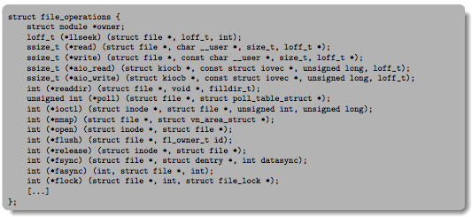
Lower Level Driver
Associated with particular hardware device
Registers / Unregisters itself with the kernel
Handler functions for each of the file operations

Slide 40
Device Drivers
Device Driver: Device-specific code in the kernel that interacts directly with the device hardware
Supports a standard, internal interface
Same kernel I/O system can interact easily with different device drivers
Special device-specific configuration supported with the ioctl() system call
Device Drivers typically divided into two pieces:
Top half: accessed in call path from system calls
implements a set of standard, cross-device calls like open(), close(), read(), write(), ioctl(), strategy()
This is the kernel’s interface to the device driver
Top half will start I/O to device, may put thread to sleep until finished
Bottom half: run as interrupt routine
Gets input or transfers next block of output
May wake sleeping threads if I/O now complete

Slide 41
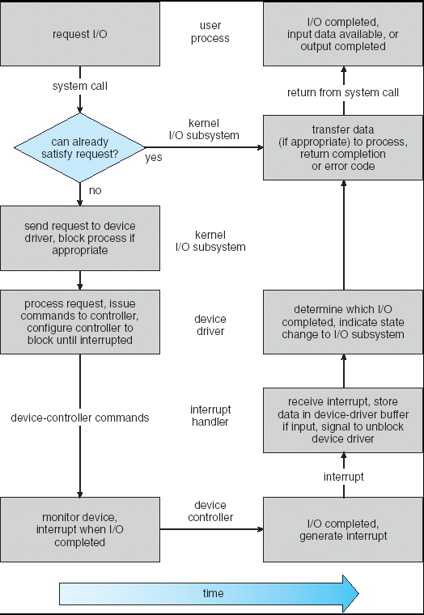
Life Cycle of An I/O Request
User
Program
Kernel I/O
Subsystem
Device Driver
Top Half
Device Driver
Bottom Half
Device
Hardware

Slide 42
Communication between processes
Can we view files as communication channels?
Producer and Consumer of a file may be distinct processes
May be separated in time (or not)
However, what if data written once and consumed once?
Don’t we want something more like a queue?
Can still look like File I/O!
write(wfd, wbuf, wlen);
n = read(rfd,rbuf,rmax);

Slide 43
Communication Across the world looks like file IO
write(wfd, wbuf, wlen);
n = read(rfd,rbuf,rmax);
Connected queues over the Internet
But what’s the analog of open?
What is the namespace?
How are they connected in time?

Slide 44
Request Response Protocol
Client (issues requests)
Server (performs operations)
write(rqfd, rqbuf, buflen);
requests
n = read(rfd,rbuf,rmax);
wait
service request
write(wfd, respbuf, len);
responses
n = read(resfd,resbuf,resmax);

Slide 45
Request Response Protocol
Client (issues requests)
Server (performs operations)
write(rqfd, rqbuf, buflen);
requests
n = read(rfd,rbuf,rmax);
wait
service request
write(wfd, respbuf, len);
responses
n = read(resfd,resbuf,resmax);

Slide 46
Client-Server Models
Client 1
Client 2
Server
***
Client n
File servers, web, FTP, Databases, …
Many clients accessing a common server

Slide 47
Conclusion (I)
System Call Interface is “narrow waist” between user programs and kernel
Streaming IO: modeled as a stream of bytes
Most streaming I/O functions start with “f” (like “fread”)
Data buffered automatically by C-library functions
Low-level I/O:
File descriptors are integers
Low-level I/O supported directly at system call level
STDIN / STDOUT enable composition in Unix
Use of pipe symbols connects STDOUT and STDIN
find | grep | wc …

Slide 48
Conclusion (II)
Device Driver: Device-specific code in the kernel that interacts directly with the device hardware
Supports a standard, internal interface
Same kernel I/O system can interact easily with different device drivers
File abstraction works for inter-processes communication (local or Internet)

